Slide 1
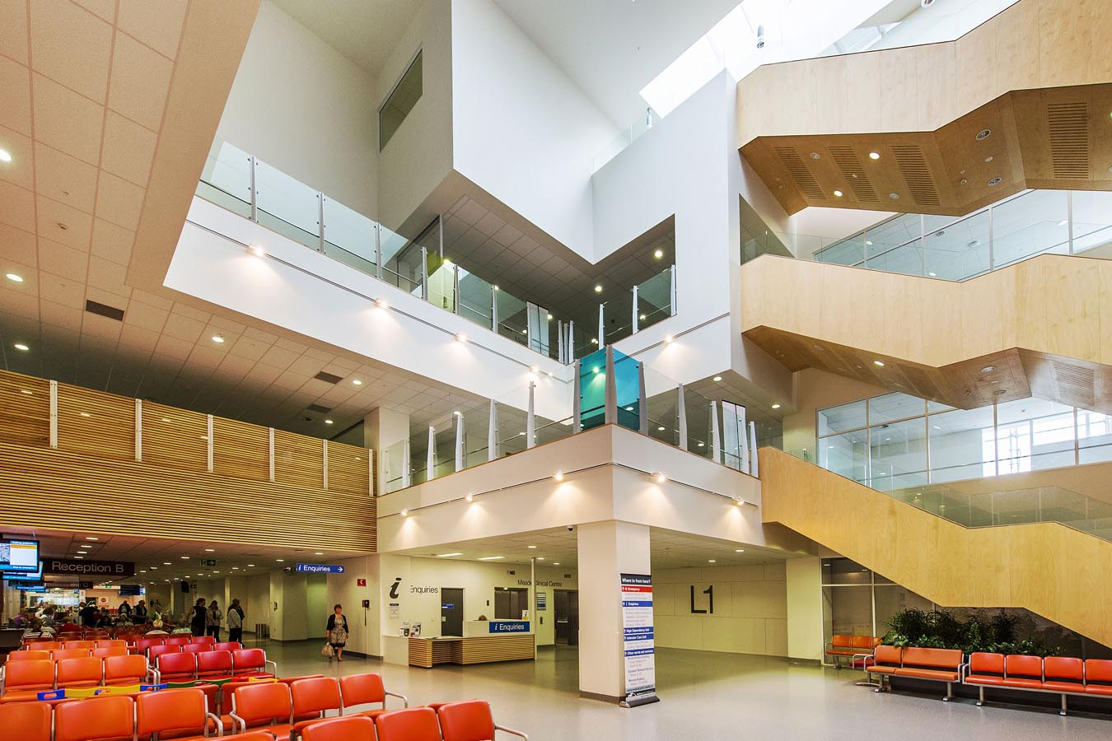
Into 2022: A vertical sector regional view on procurement
Stephen Greenhough
Director Property & Infrastructure
Waikato District Health Board

Slide 2
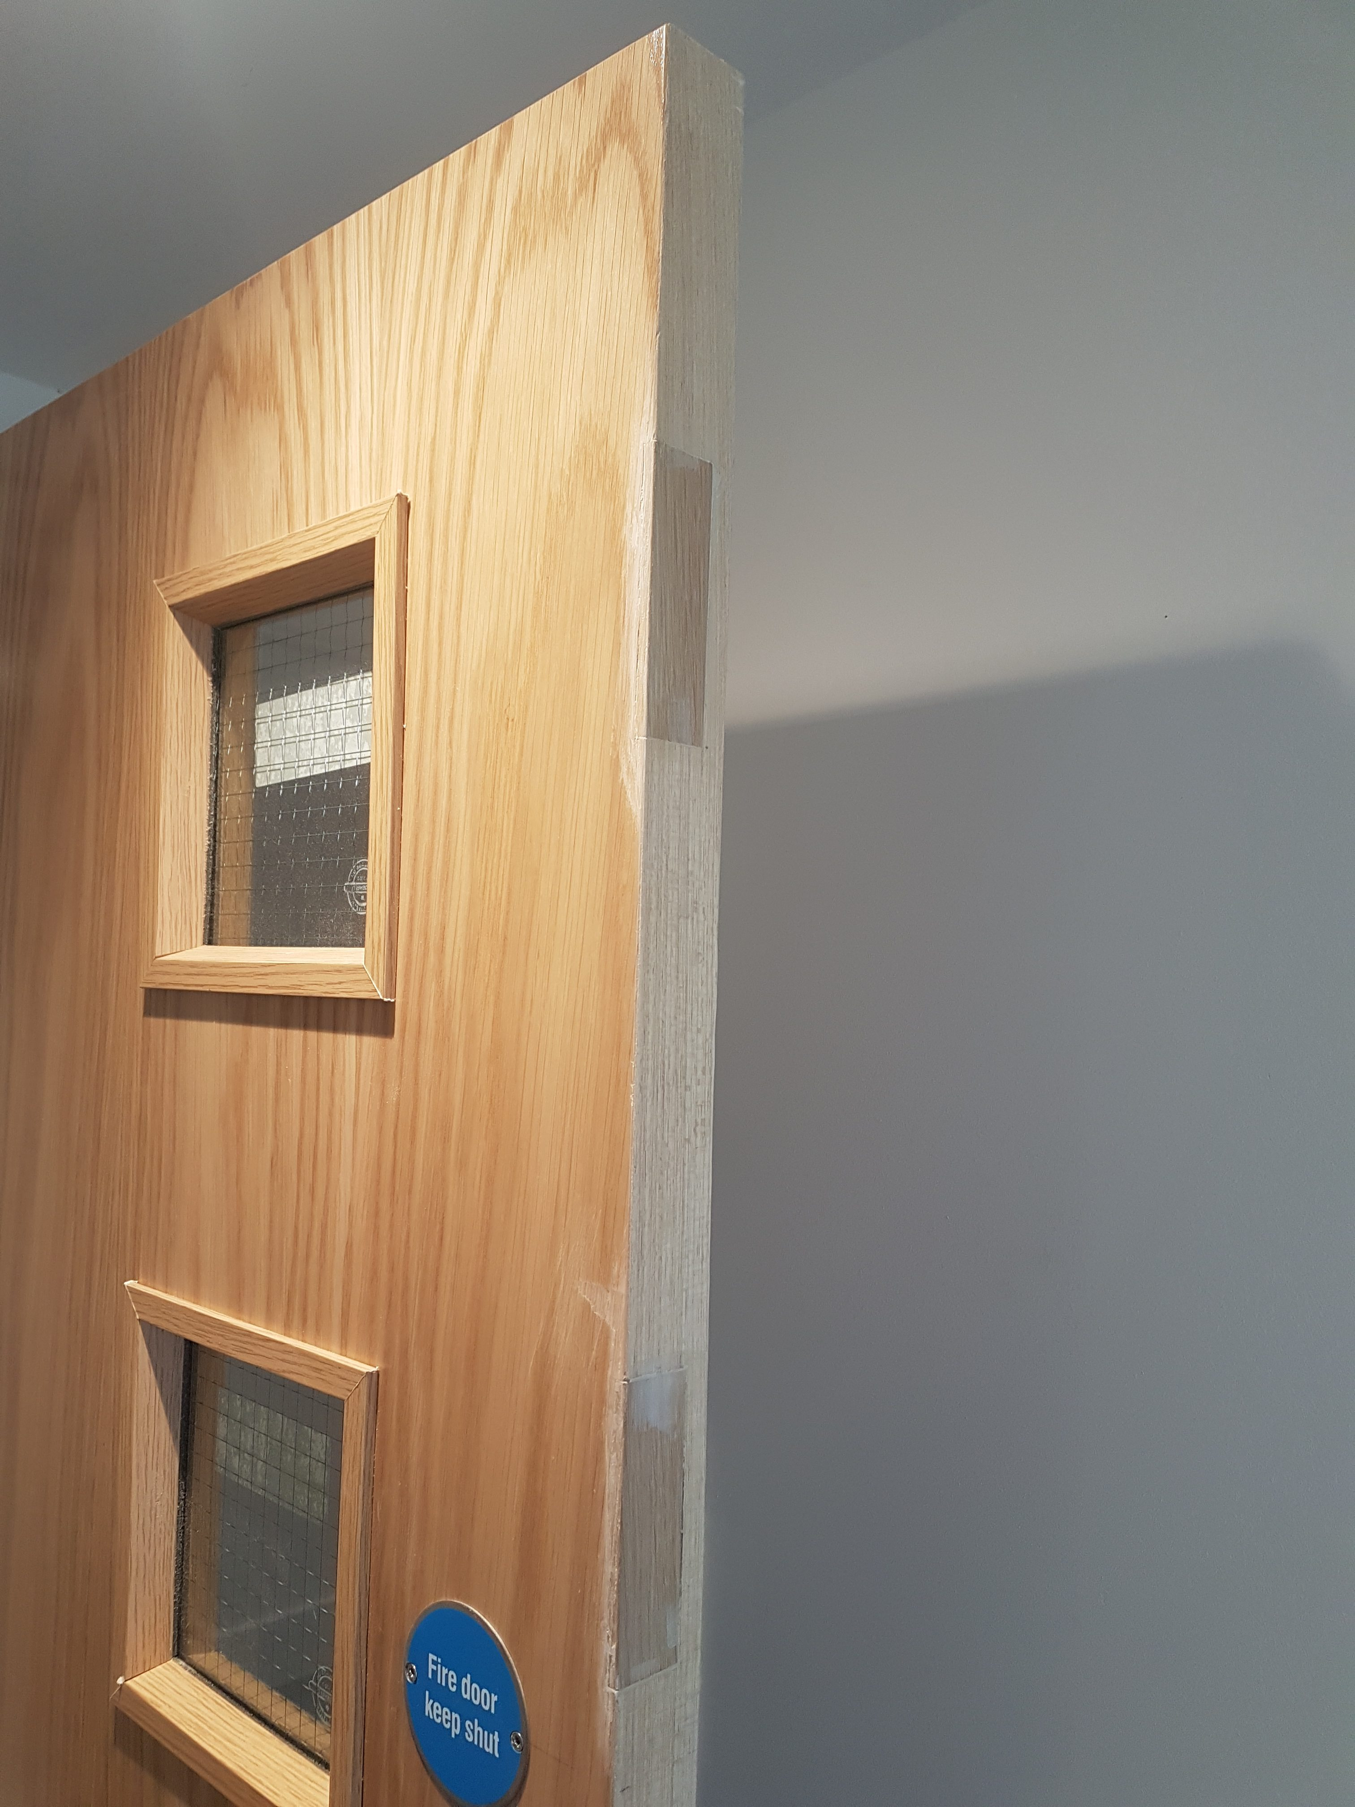
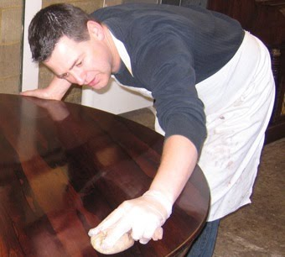
The French Polisher

Slide 3
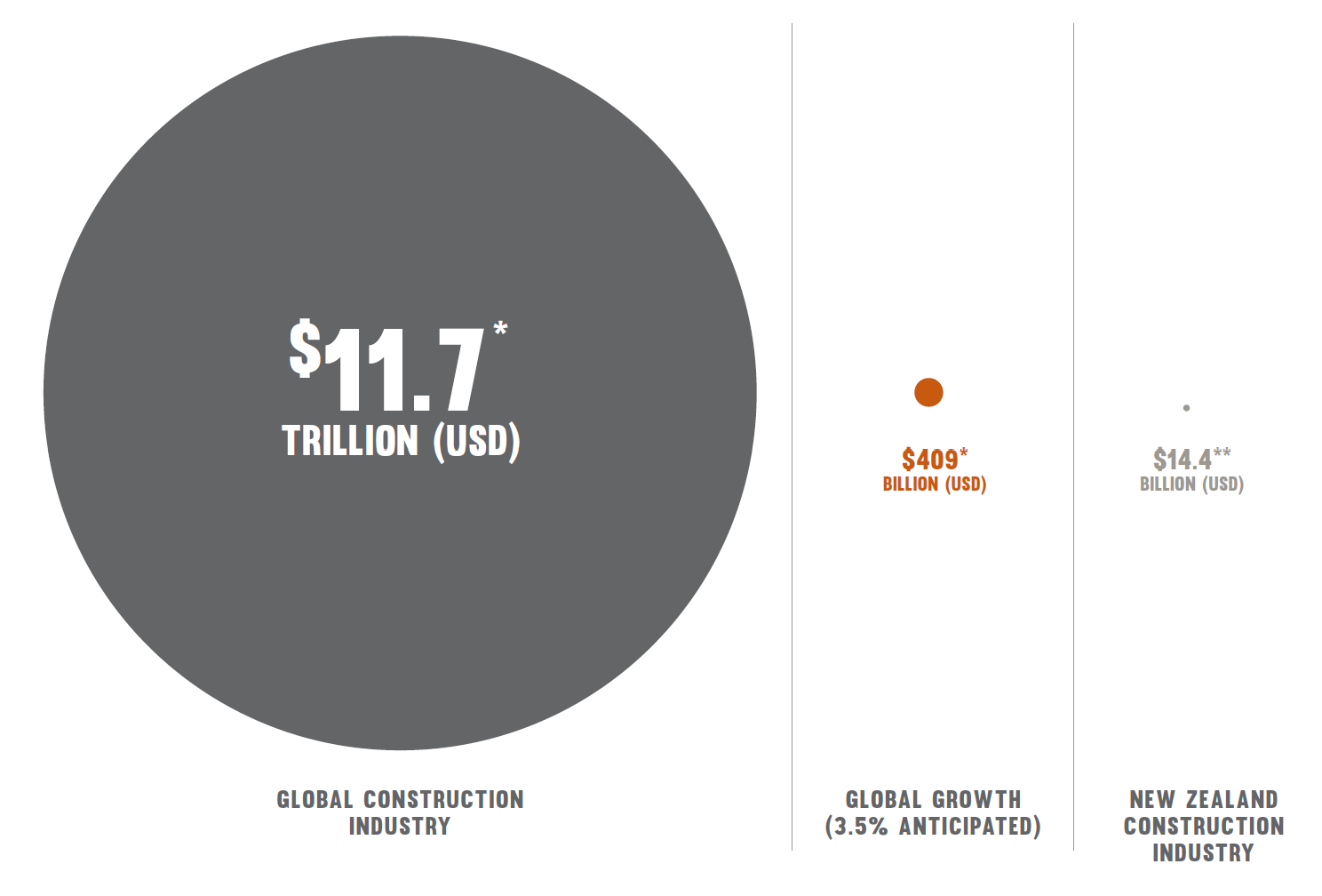
NZ is a small market
Source: EBOSS Construction Supply Chain Report 2021

Slide 4
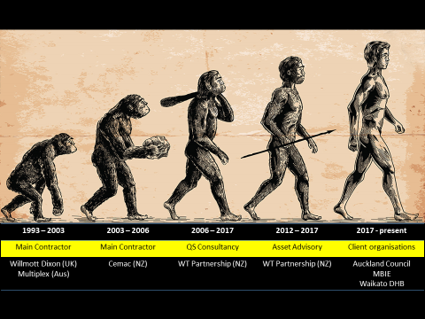
Career Evolution

Slide 5
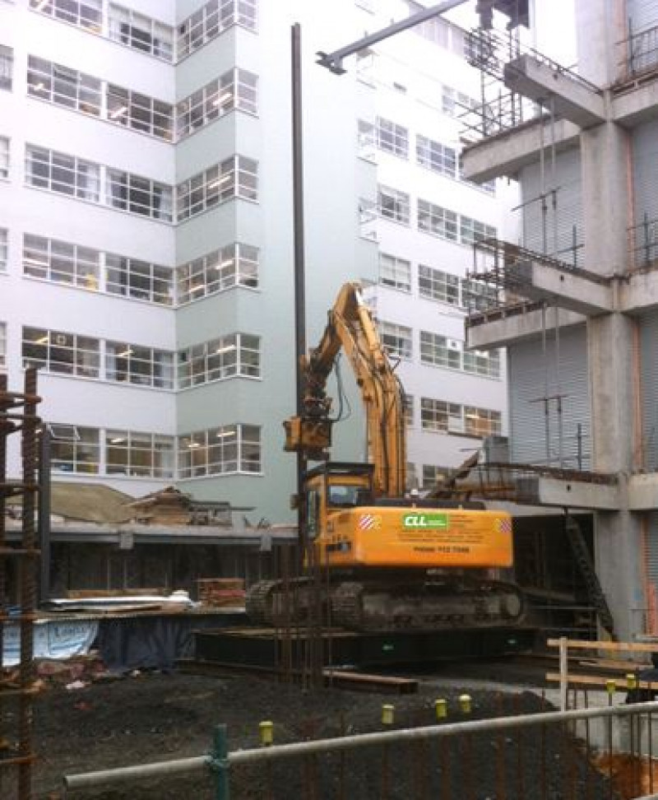
Agenda
System level
What we need regionally
Regional context
How can we intervene
Conclusion
Questions

Slide 6
System level

Slide 7
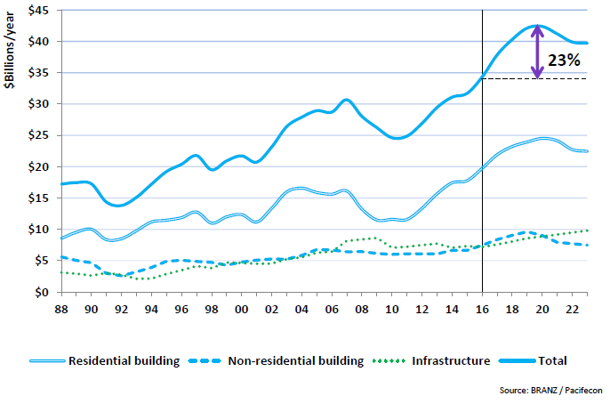
Construction Growth

Slide 8
What next

Slide 9
Sector Accord Successes
COVID-19 Contract guidance
Beacon Project awards
Carbon reduction guidelines
Championing of Mates
COVID-19 Risk Management Guide
Coming: Broader outcomes toolkit
Source: www.constructionaccord.nz

Slide 10
What we need regionally
Certainty
Certainty on pipeline
Making investment approval processes more fluid
Putting more weight into the national pipeline
Certainty of costs
Shoring up supply issues within national control e.g. timber

Slide 11
Regional context

Slide 12
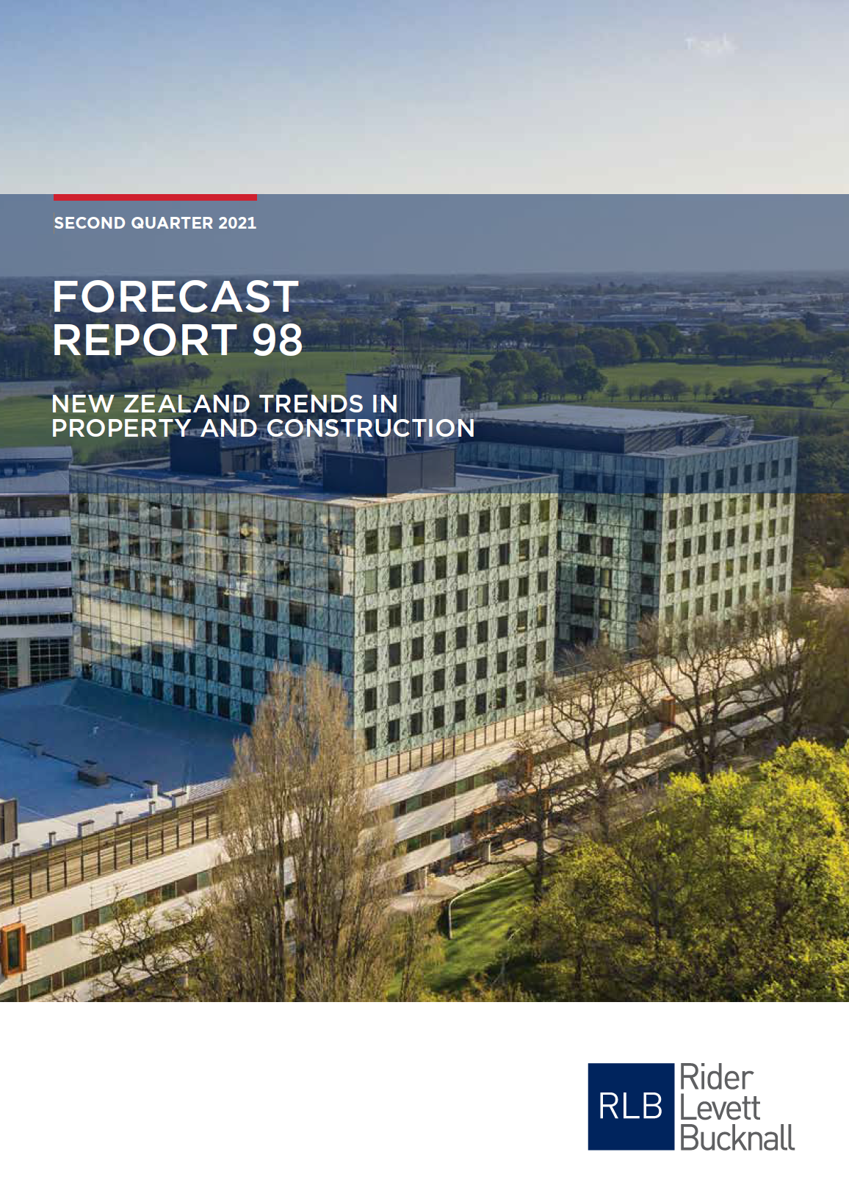
Escalation
5% cost escalation p.a.
By 2023 reduces to 3% - 4%
Escalation outstripping CPI by 30%
oiiiover 10 years
Source: www.rlb.com

Slide 13
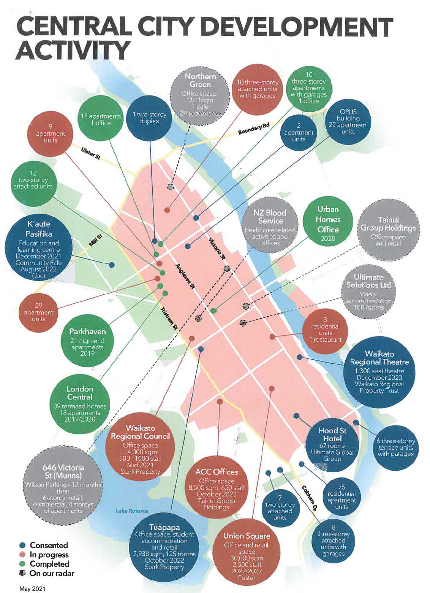
Causes
Scarcity of resource - labour
Wellbeing
Auckland supply chain issues
Materials supply generally
Source: www.aecom.com

Slide 14
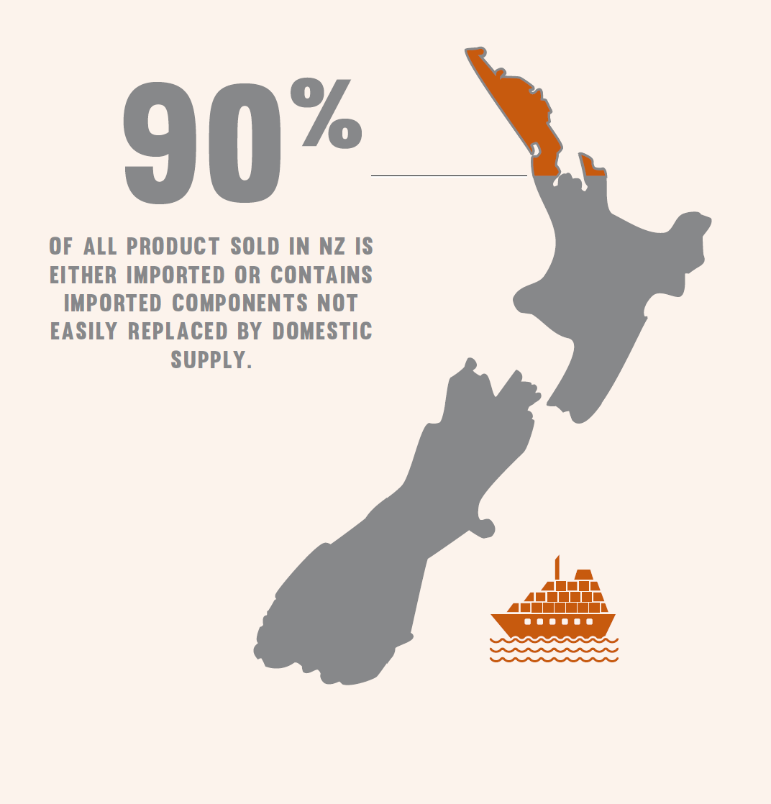
How can we intervene
Develop local resources
Wellbeing into how we buy
Local supply chain networks
Selection of materiality
Source: EBOSS Construction Supply Chain Report 2021

Slide 15
Conclusion

Slide 16
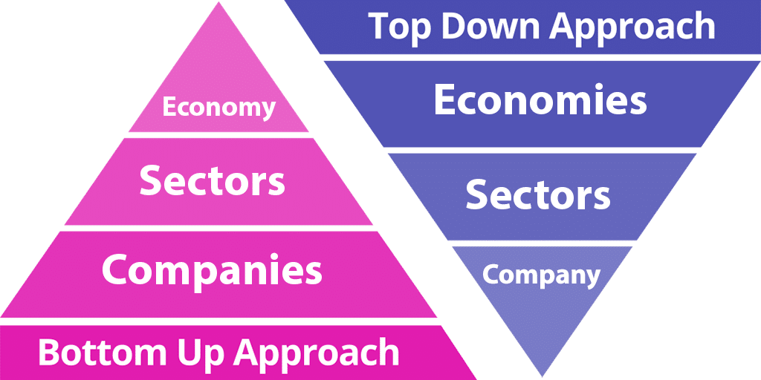
Conclusion
Environment of certainty
Develop local resources
Wellbeing into how we buy
Local supply chain networks
Oii”localism”
Selection of materiality

Slide 17
Questions

